Slide 1
Software Quality Engineering
Lecture 1-Chapter 1
Overview and Basics
Alina Arshad
alina.arshad@nu.edu.pk

Slide 2

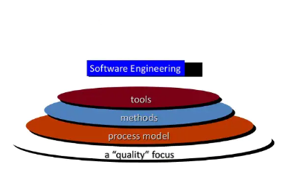

Slide 3
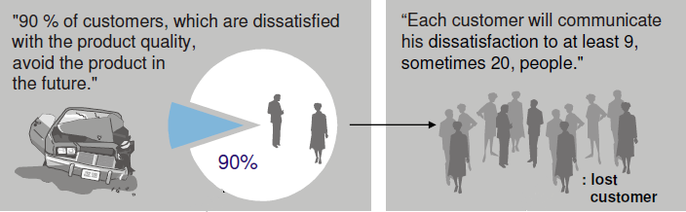

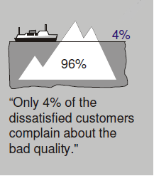
Consequences of Bad Quality

Slide 4
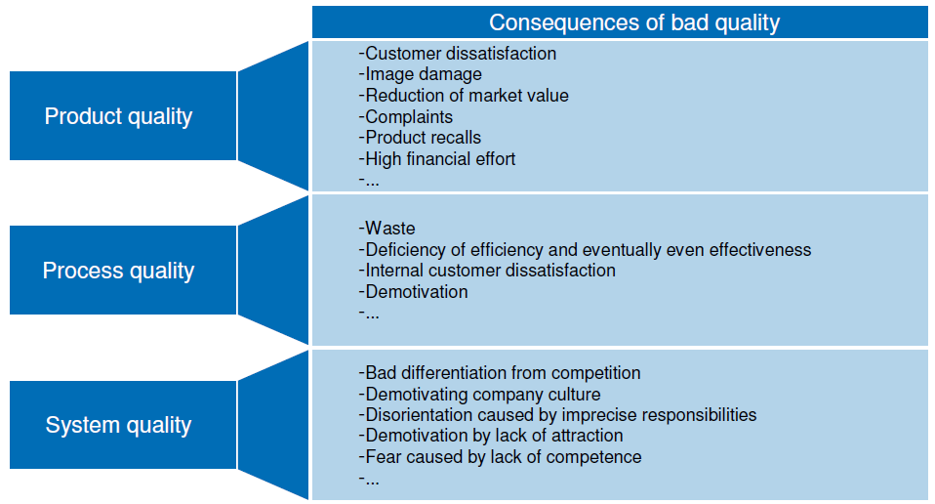
Consequences of Bad Quality

Slide 5
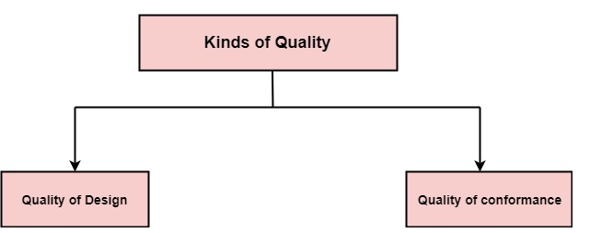
Kind Of Quality
Quality?
Two kinds of quality
Quality of design
Quality of Conformance

Slide 6
Quality Of Design vs Quality of Conformance
Quality of design is the degree to which the designers is intending to provide its customers.
Quality of conformance is the degree to how well a product or service meets its specifications.
Notes:
Related to requirements
https://www.chegg.com/homework-help/questions-and-answers/1discuss-detail-differences-quality-design-quality-conformance-impact-production-cost-also-q31556930

Slide 7

Quality Management
The term Quality management has a specific meaning within many business sectors. This specific definition can be considered to have the following main components:
Quality Assurance (QA)
Quality Planning (QP)
Quality Control (QC)
Quality Steering (QS)

Slide 8

Are QA And QC Same Terms?
BIG NO, these both terms are effectively different.
Most of the time we use both terms randomly, hence to study and understand the difference between them is important.

Slide 9
Quality Management (cont…)
Quality Assurance
Quality Planning
The establishment of a framework of organizational procedures & standards that lead to high-quality software.
The selection of appropriate procedures and standards from this framework, adapted for a specific software project.
Quality Control
Quality Steering
The definition and enactment of processes that ensure the software development team have followed project quality procedures and standards.
Planning constructive QA measures & re-planning based on quality control results.

Slide 10


QA vs QC

Slide 11
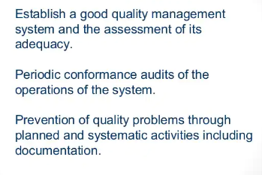
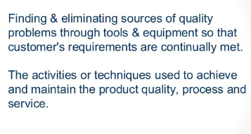
How to achieve QA/QC goals
QA goals
QC goals

Slide 12
Responsible for QA/QC
Everyone on the team involved in developing the product is responsible to quality assurance
Quality control is usually the responsibility of a specific team that tests the product for defects

Slide 13
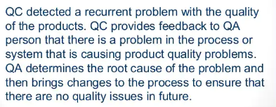
QA and QC

Slide 14
Origin of Quality Management
The concept of ‘quality’ came out with industrial revolution.
Earlier the product would be crafted by a single person or a team of people overseeing all aspects of ‘quality’ criteria.
Mass production brought large teams working on a product in different stages of production.

Slide 15
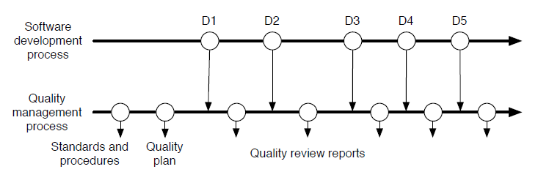
Software Development & Quality Management
Quality management must occur continually during software development.

Slide 16
Software Quality and Productivity
The most effective way of improving software productivity and shortening project schedules is to reduce defect levels.
Defect reduction can occur through:
Defect Prevention Techniques
Defect Removal Techniques
Structured design and JAD
Structured code
Use of inspections, static analysis
Reuse of certified components
Design inspections
Code inspections, static analysis
Formal Testing using mathematical test case design

Slide 17
Cost of Quality - Concept
Organizations need to be aware of the costs associated with making errors as a way of identifying areas for improvement.
Money is lost due to rework if the work is not performed in a way that it should be.
“Do it right first time every time” attitude is necessary.

Slide 18
The Quality Is Free Concept
Quality products and services
Increased business and profits
Greater customer satisfaction

Slide 19
Cost of Quality - Definition
The total costs incurred on quality activities and issues and often split into prevention costs, appraisal costs, internal failure costs and external failure costs.
Money spent beyond expected production costs (labor, materials, equipment) to ensure that the product the customer receives is a quality (defect free) product. The Cost of Quality includes prevention, appraisal, and correction or repair costs.

Slide 20
Cost metrics/parameters for the evaluation of an SQA Plan
Percentage of cost of software quality out of total software development costs
Percentage of software failure costs out of total software development costs
Percentage of cost of software quality out of total software maintenance costs
Percentage of cost of software quality out of total sales of software products and software maintenance.

Slide 21
Any question????

